Slide 1
New directors’ Welcome
May 2023

Slide 2
Office of the Executive Vice President/VP for Academic Affairs
Nicholas P. Jones, PhD
Executive Vice President/Vice President for Academic Affairs
Sarah M. Zehr Gantz, PhD
Senior Assistant Vice President of Academic Initiatives and Policies

Slide 3
Introduce yourself!
In one minute:
What is your name?
Where do you work?
How long have you been in your director role?
Answer any of these questions:
Do you have a superpower or what is one you wish you had?
What is your favorite hobby?
What was your first job?
What is something cool that very few people know about you?

Slide 4
CARLI is a membership organization representing 128 academic and research libraries in Illinois Formed in 2005
Three organizations came together to improve efficiency
and to provide new opportunities for collaboration:
Illinois Cooperative Collection Management Program (ICCMP)
Illinois Digital Academic Library (IDAL)
Illinois Library Computer Systems Organization (ILCSO)

Slide 5
CARLI by the numbers
128 member libraries
Governing members: 128
Public universities: 13
Community colleges: 39
Private, research, and special: 76
CARLI member libraries serve 90% of Illinois higher education students, faculty and staff.

Slide 6
Mission and Values
CARLI Mission
We empower our academic and research libraries to build and sustain an accessible, diverse, and responsive knowledge environment that promotes excellence and innovation in teaching, learning, and research. CARLI adds value for all member libraries by sharing costs, collections, expertise, programs, products, and services.
CARLI Statement of Values
We are committed to:
Diversity, equity, inclusion, and accessibility
Intellectual freedom, privacy, and open access to information resources
Careful stewardship of all CARLI resources
Advocacy for academic and research libraries at the local, state, regional and national levels
Supporting cooperation and engagement among academic and research libraries
Being responsive to member needs
Identifying and implementing collaborative solutions to shared challenges and reducing barriers

Slide 7
Carli’s relationship with university of Illinois System
CARLI is a unit of the University of Illinois System Offices under Executive Vice President and Vice President for Academic Affairs, Dr. Nicholas Jones
CARLI employees are University of Illinois System employees
University of Illinois System Offices provides:
Staff salaries, benefits
HR and legal counsel support
Purchasing, licensing and contracting support
Desktop computer support and network services
CARLI is bound by the rules and regulations of the University as a state funded institution
Purchasing, procurement and auditing
Competitive bidding
Recruitment and personnel policies

Slide 8
CARLI and the University’s strategic Framework
As a unit of the University of Illinois System Offices, the Consortium of Academic and Research Libraries in Illinois (CARLI), asserts that it is a vibrant and outstanding example of public good, scalable solutions, and a model for leveraging the full resources of the University, as aspired to in the University’s 2016-2026 Framework, cited below:
“The University of Illinois System reaffirms the central role that education and higher education in particular can play in promoting the public good for the entire State of Illinois and beyond.
“This framework is designed to unleash the collective potential of our institutions and our geography, creating an array of reforms and solutions that are scalable and replicable elsewhere…”
-Introduction
“Develop information and tools that make the full resources of the University (e.g., courses, research opportunities, service-learning experiences, information and data) accessible to students so that we become a next-generation model for the distributed public university system.”
-Pillar I.1.

Slide 9
CARLI’s Host Institution Agreement, Dec. 2017

Slide 10
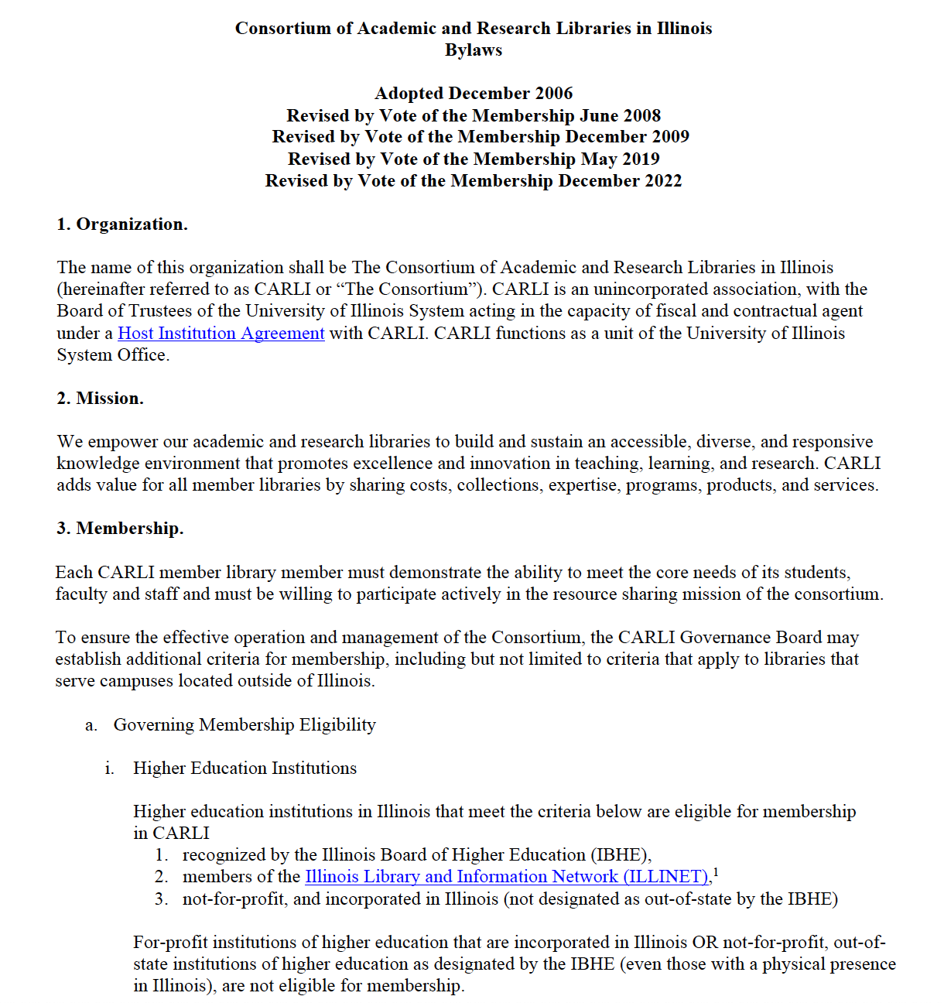
CARLI’s BYLAWS

Slide 11
CARLI Committees
Board Committees
Executive Committee
Finance Committee
Personnel Committee
Program Planning Committee
Scholarship Committee
Standing Committees
Collection Management Committee
Commercial Products Committee
Created Content Committee (committee is currently on hiatus)
Discovery Primo VE Committee
E-Resources Management Committee
Instruction Committee
Open Educational Resources Committee
Preservation Committee
Public Services Committee
Resource Sharing Committee
Technical Services Committee
Task Forces
Archives Task Force
Diversity Equity and Inclusion Task Force

Slide 12
CARLI Office: 26 FTE
Anne Craig, Senior Director
MEMBERSHIP AND COMMUNICATIONS Margaret Chambers, Director and Advisor, Membership and Communication
Michelle Haake, Senior Coordinator Membership & Communications
Ed Schell, Web Developer
Nicole Swanson, Senior Coordinator, Library Services and Outreach
BUSINESS AND FINANCE SERVICES Diane Day, Fiscal Officer
Tim David, Accounting Specialist
Katrina Little, Invoicing Specialist
COLLECTIONS SERVICES Elizabeth Clarage, Director, Collections Services
Michele Leigh, Senior Coordinator, Open Illinois
E-RESOURCES Jenny Taylor, Associate Director, Electronic Resources
Denise Green, Senior Library Services Coordinator
Nicole Ream-Sotomayor, Senior Electronic Resources Coordinator
Marisa Tolbert, Library Services Coordinator
SYSTEMS SERVICES
Jessica Gibson, Assistant Director, System Services
Christopher Delis, Application Support Specialist
Todd Pavlik, Data Coordinator
Megan Pearson, Visiting Library Services Coordinator
Annie Serrano, Senior Library Application Coordinator
Bradley Woodruff, Library Application Support Consultant
USER SERVICES Jennifer Masciadrelli, Assistant Director, User Services
Debbie Campbell, Senior Library Services Coordinator
Martin Kong, Library Services Coordinator
Amy Maroso, Senior Digitization Coordinator
Adrienne Radzvickas, Library Services Coordinator
Ted Schwitzner, Senior Library Services Coordinator

Slide 13
Our members tell us…
CARLI staff act as surrogate staff for libraries so that they can focus on supporting their users and collections.
CARLI staff perform highly specialized and time-intensive work like managing online catalogs or contract negotiations for e-resources so that these functions need not be replicated in full at libraries.
CARLI frees dollars within each member organization to do mission-critical work.

Slide 14
Membership in a nutshell
Not-for-profit institutions
Vote for Board members
Eligible for all services
Staff may serve on committees

Slide 15
Where to find your fees/assessments
CARLI Membership Fees for FY22–27: https://www.carli.illinois.edu/sites/files/files/MembershipFees.pdf
I-Share Assessments for FY22–FY27: https://www.carli.illinois.edu/sites/files/files/I-ShareAssessments.pdf

Slide 16
FY19 board action on reserve fund
Approximately $4.5 million kept in reserve fund
Part 1: I-Share Planning
Reserve and build on an amount equal to the Ex Libris Alma/Primo VE one-time migration and implementation fees ($2,346,325), with a 1.5% annual increase beginning in FY20.
Part 2: CARLI Operating Reserves
Reserve and build on an amount equal to six months of the state appropriation to CARLI

Slide 17
CARLI Revenue sources FY23
 | FY2022 | FY2023 | change
University of Illinois System Office | $3,575,124 | $3,767,700 | $192,576 | 5.3% | -5%
Membership Fees | $465,291 | $490,255 | $24,964 | 5.1% | -10%
I-Share Assessments | $1,838,848 | $1,883,349 | $44,501 | 2.4% | 3%
Pass-through revenue | FY2022 | FY2023 | change
Subscriptions to databases estimated for FY23 | $14,650,642 | $14,890,000 | $239,358 |  | 1.6%
ILDS (Illinois Library Delivery Service) grant (IL State Library) estimated for FY23 | $880,438 | $916,705 | $36,267 |  | 4.0%

Slide 18
CARLI State Funding Allocations FY12-Fy22

Slide 19
Value of carli to member libraries: an overview
When a member pays | The member will receive
Membership Fee | Continuing education EBSCO databases (and other at-no-cost content) Consortially shareable ebooks CONTENTdm (CARLI Digital Collections) OpenAthens through June 30, 2023
I-Share Assessment | I-Share
Discretionary purchases | Subscription e-resources and databases (no surcharge) Services like NC Live Web Design
No member pays | ILDS (Illinois Library Delivery Service) Paid for by a grant from SOS/ISL

Slide 20
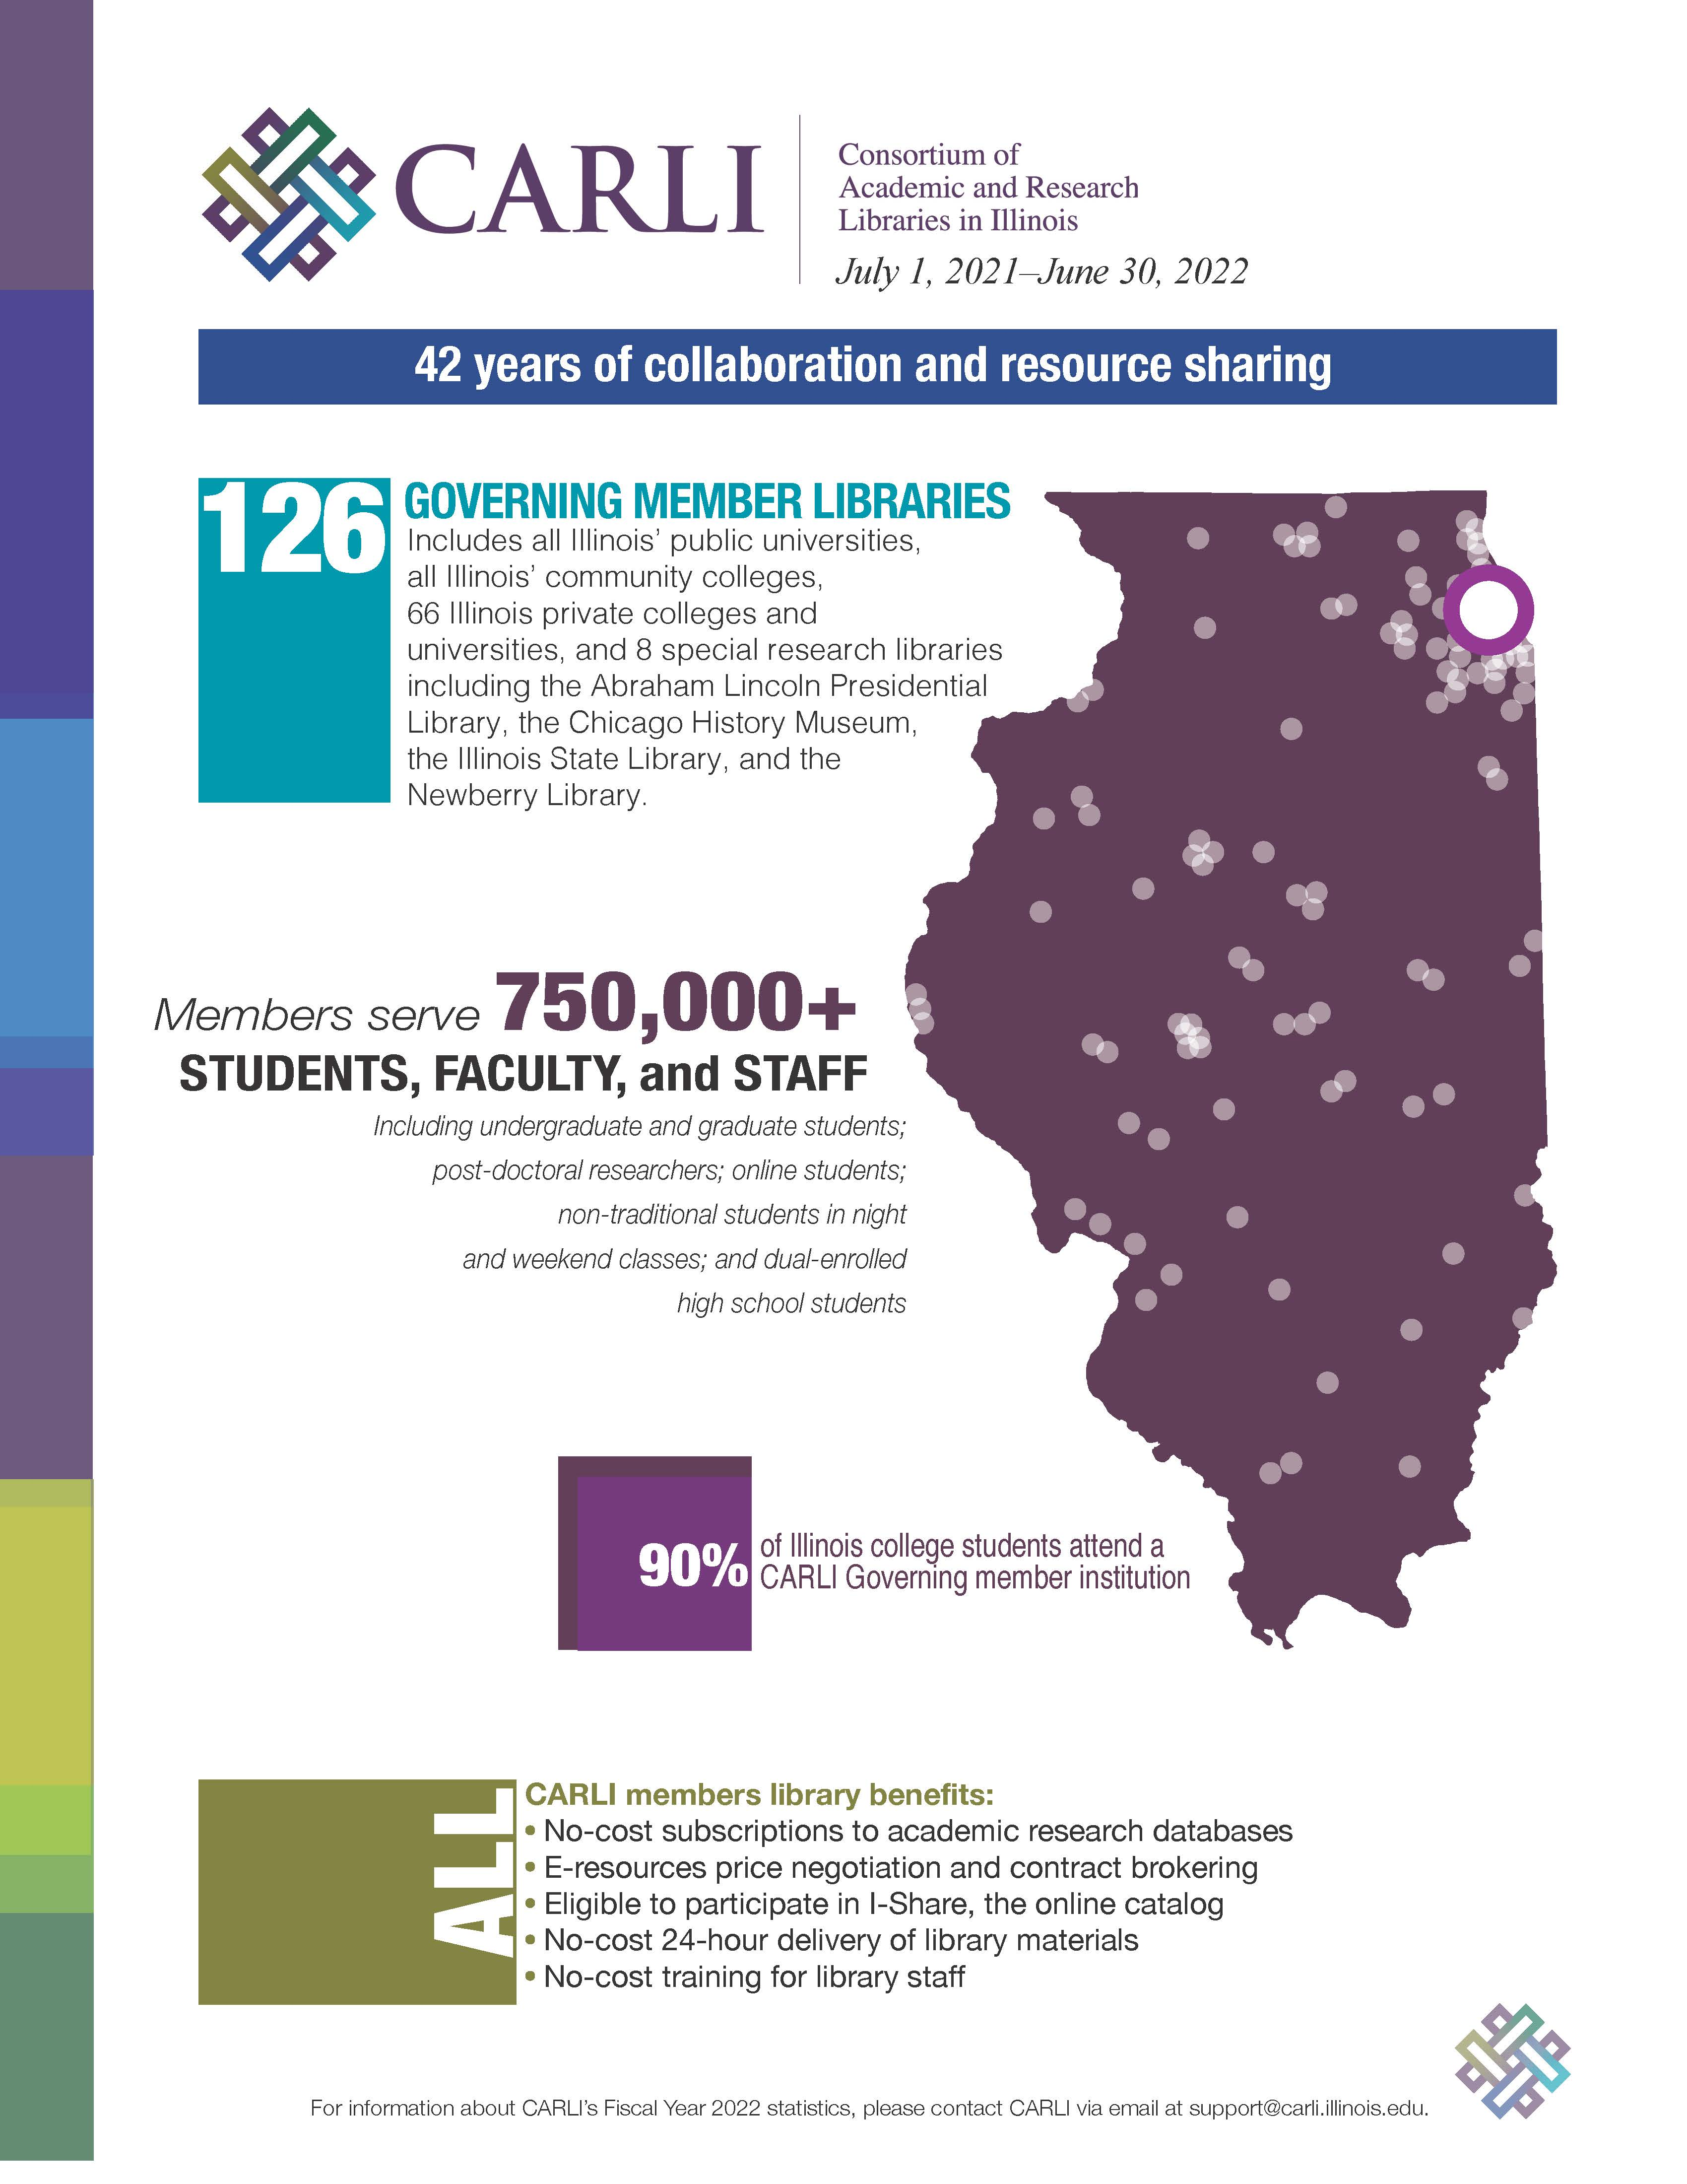
https://www.carli.illinois.edu/sites/files/files/FY2022ValueGraphics.pdf

Slide 21
https://www.carli.illinois.edu/sites/files/carlidocs/AboutCARLI.pdf

Slide 22
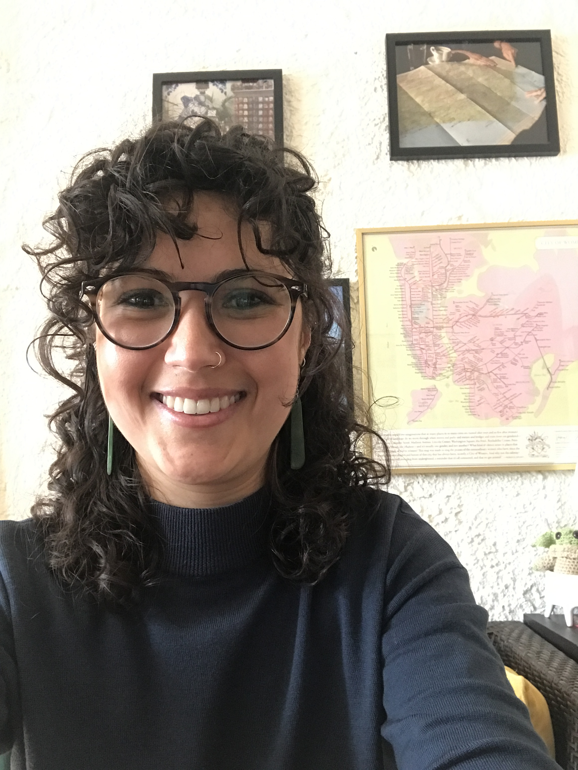
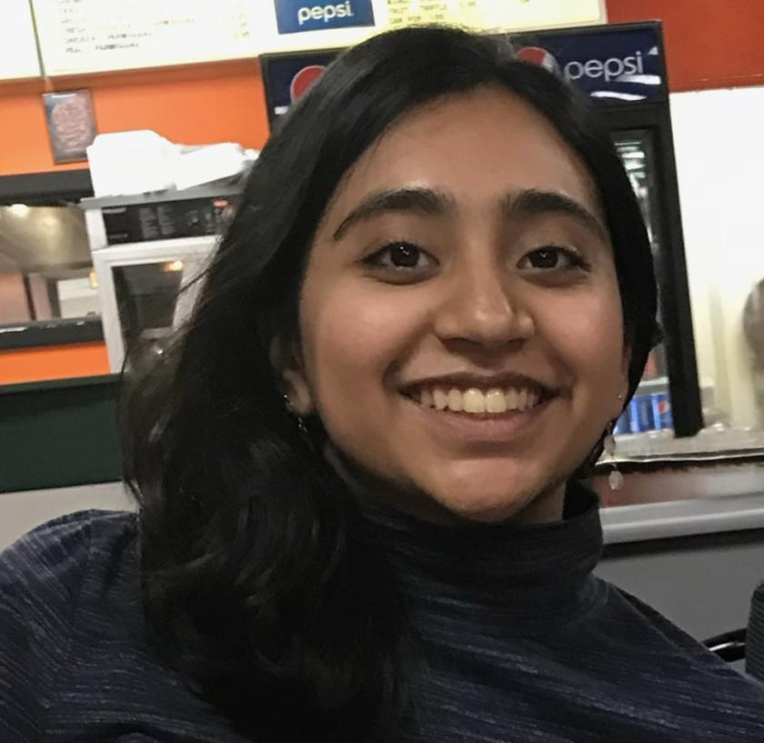
Major accomplishments FY23
Illinois SCOERs: Support for the Creation of Open Educational Resources
Building Diversity Graduate Assistant Program
Negotiated pricing for new I-Share libraries
Inaugural recipients of BDGAP
Sarah Rebecca Gaglio
Wardah Mohammed

Slide 23
Other significant accomplishments
Moved to a new location
Brokered $15 million in optional databases
Crowdfunded another year of ebooks
Hosted Professional Development Alliance webinars
Migrated responsibility to CARLI for Illinois’ presence in the Digital Public Library of America
Drafted a new Strategic Plan
Wrapped up Cohort 3 of CARLI Counts
Awarded three iSchool scholarships (privately funded)
Worked with iSchool’s Business Intelligence Group
Embarked on Shared Institutional Repository with UIUC Library
Invited to apply: CARLI Counts follow-on federal grant

Slide 24
Carli services
Centralized automated systems
I-Share (Alma/Primo VE)
CARLI Digital Collections/IDHH/DPLA
E-resources and collection development
Subsidized core electronic resources
Database brokering
Perpetual access acquisition (subsidized and one-time purchase)
Consortially shareable e-books
Open Illinois (CARLI’s OER initiative)
Training and continuing education; professional development
Grant-funded initiatives
CARLI Counts
Illinois SCOERs
Physical delivery service
CARLI SUPPORTS ITS MEMBERS!

Slide 25
Centralized Automated Systems

Slide 26
i-Share
I-Share is regularly named as the most valued service CARLI provides.
88 libraries are current I-Share members, we have already started the process of adding our new members and when that is complete we will have 96 I-Share members!
A community of users of Alma/Primo VE throughout the State of Illinois, supported by staff at the CARLI Office.

Slide 27
I-Share
At the center of I-Share is Resource Sharing
Resource Sharing benefits all I-Share institutions
Power of the shared catalog means our faculty, staff, and students can take advantage of collections throughout the state with 24-hour delivery through ILDS
Familiarity with I-Share among the student population means that transferring students enter new schools in Illinois with an advantage

Slide 28
CARLI Digital Collections
Nearly 360 collections provided by 49 different institutions
Over 3.1 TB of images and metadata
https://collections.carli.illinois.edu
Notes:
CARLI Digital Collections has nearly 340 collection contributed by 47 member libraries. With the switch to a responsive version of the CONTENTdm platform in 2020, the site is phone and tablet friendly. CARLI DC is provided at no cost to governing members.

Slide 29
Illinois digital Heritage Hub (IDHH)
Collaborative venture among CARLI, ISL, CPL & UIUC
CARLI staff support REPOX harvester
IDHH currently contributing over 516,000 metadata records from:
CARLI:
CARLI Digital Collections plus
DePaul University, Illinois State University, Northern Illinois University, University of Illinois Urbana-Champaign
Chicago Public Library
Des Plaines Public Library
Illinois State Library’s Illinois Digital Archives
Madison Historical (online encyclopedia & digital archive for Madison County)
DPLA information page for CARLI members: https://www.carli.illinois.edu/products-services/contentdm/dpla
IDHH DPLA portal: https://idhh.dp.la/
Notes:
The Illinois Digital Heritage Hub is the Illinois DPLA service hub. In addition to CARLI Digital collections, carli also uploads the Chicago public library, Des Plaines Public Library, the Illinois digital archives, and the Madison historical collections to DPLA. Of the over 516,000 records the IDHH contributes to DPLA, CARLI Digital Collections accounts for over 238,000 of them. The Illinois digital heritage hub is a wonderful collection of digital resources from all over Illinois. I urge you to check it out

Slide 30
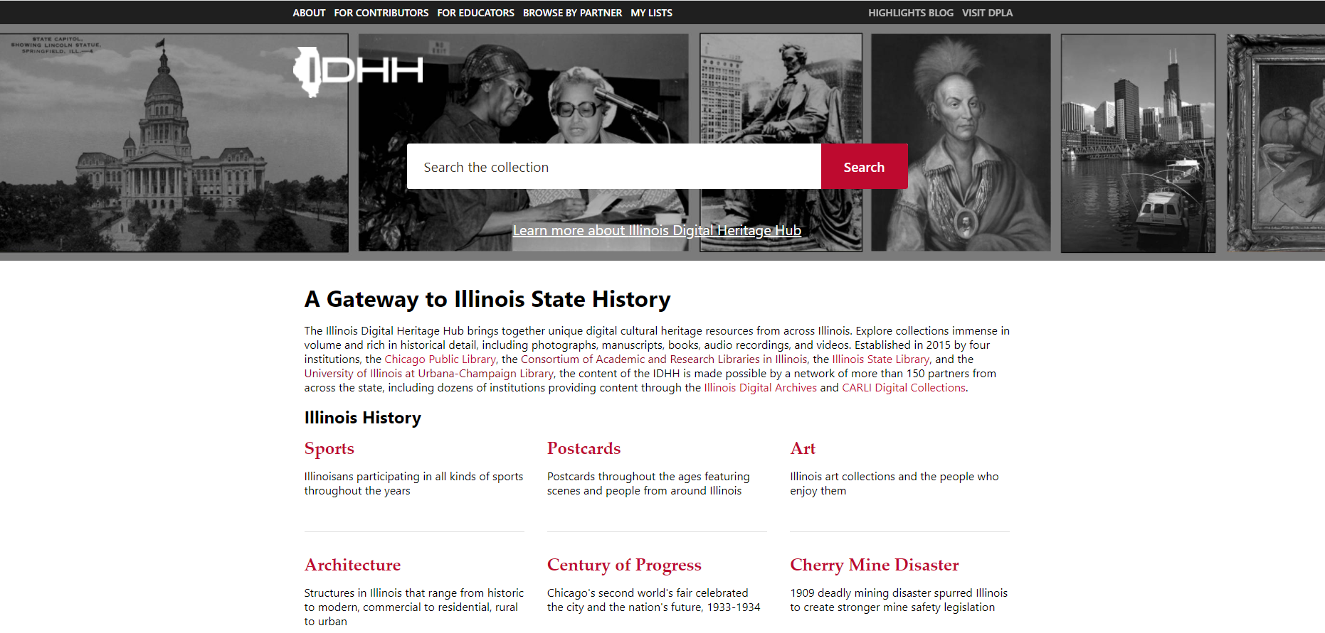
https://idhh.dp.la/
Notes:
Please check out the IDHH website…it’s quite wonderful!

Slide 31
E-Resources

Slide 32
Program Purpose:
to make it possible for CARLI members to expand and enhance their library collections with both subscription and perpetual access to electronic resources in a more efficient and affordable manner
Most widely used service (126 libraries)
Approximately $15 million
Great prices: bargaining power of 128 libraries
Straight pass-thru cost ~ no surcharge

Slide 33
All Governing Member Libraries at No cost, FY23
EBSCO Academic Search Complete
EBSCO Business Source Elite
Mary Ann Liebert Journals (2005-2010 content only)
EBSCO provides access to:
Consumer Health Complete
ERIC
Health Source: Consumer Edition
Health Source: Nursing/Academic Edition
MasterFILE Premier
MAS Ultra: School Edition
Military and Government Collection
Newspaper Source
Primary Search
Professional Development Collection
Regional Business News
Permanent acquisitions
Harper’s Weekly, 1857-1912
Illinois Digital Sanborn Maps
Saskia Fine Art Images
Springer Medicine E-books (2005-2010)
Sage E-Journal 2007 Deep Journal Backfile Collection
Historical Statistics of the United States
Sage E-reference collection
Women and Social Movements in the U.S.
Black Thought and Culture

Slide 34
CARLI e-resources Brokering webinar
https://www.youtube.com/watch?v=z3HZOd9Oa8E

Slide 35
Collection Development

Slide 36
Ebook project: Benefits of the program
Resource sharing is highly valued
Crowdfunding can work
Member support provides great access and ownership!
More than what any one member can individually purchase

Slide 37
Training and professional Development

Slide 38
Professional development alliance
CARLI partners with nine other library consortia to create the Professional Development Alliance
No-cost opportunities
Several every month; on the CARLI Event Calendar
Find recordings and slides from past programs at https://www.carli.illinois.edu/products-services/prof-devel
We are eager for your suggestions! support@carli.illinois.edu

Slide 39
Grant-funded activities

Slide 40
OPEN TEXTBOOKS PILOT GRANT
Illinois SCOERs: Support for Creation of Open Educational Resources
https://www.carli.illinois.edu/products-services/collections-management/IllinoisSCOERs
$2 million, three-year grant from the US Department of Education
Notes:
The Fund for the Improvement of Postsecondary Education (FIPSE) in the U.S. Department of Education has awarded a $1.08 million grant to the University of Illinois System/CARLI for Illinois SCOERs (Support for Creation of Open Educational Resources). Illinois SCOERs activities began September 1, 2021, and will extend to August 31, 2024.
Members applying as part of a project team will be encouraged partner with faculty/staff from other institutions in order to maximize savings to students and to impact the greatest number of students
Open textbooks:
are created by educators;
are peer reviewed by experts in the field;
contribute to successful learning outcomes
reduce students’ expenses/debt
open opportunities for equity and social justice

Slide 41
HIGH-LEVEL OUTCOMES OF ILLINOIS SCOERs
Eliminate textbook costs for high-enrollment courses in the focus area in CARLI member institutions
Improve student learning outcomes by increasing the use of open-source materials by including personal learning experiences
Develop local expertise about OER and ancillary creation, publishing, dissemination, adoption, and use
Create a scalable OER model that can be replicated across multiple disciplines and institutions
https://www.carli.illinois.edu/products-services/collections-management/IllinoisSCOERs
Notes:
We look forward to working with you to make college and university more affordable and enriching the learning experience for Illinois students

Slide 42
CARLI links the profession
CARLI is depended on to enrich professional lives
CARLI helps libraries “level the playing field”
“The value of colleagues working together—community colleges, private institutions, public institutions, small and large—is that the collaboration makes so many projects possible and gives us a springboard to shape important library services.”
University of Illinois at Chicago
“Story telling class under Miss Lilly Riley,”
Seven Settlement Houses, 1920s

Slide 43
Communicating with you
Email lists: https://www.carli.illinois.edu/email-lists
Website: https://www.carli.illinois.edu/
CARLI Support Email: support@carli.illinois.edu
Toll-free phone: (866) 904-5843
Monthly Newsletter
Directors’ Updates emails
Annual “Value Letter” for each member
Board / Committee / Task Force: minutes available
CARLI Calendar: registration info listed ASAP
System Status Updates on homepage
ILDS satisfaction survey—every January

Slide 44
We’d love to hear from you!
217-244-7593 or 866-904-5843 support@carli.illinois.edu http://www.carli.illinois.edu
Anne Craig Senior Director
217-300-0375 abcraig@uillinois.edu

